Slide 1
An introduction to common knowledge graphs
Yuchen Sha
2016.4.8

Slide 2
Terminology
Ontology:
“a formal naming and definition of the types, properties, and interrelationships of the entities that really or fundamentally exist for a particular domain of discourse”
Knowledge base:
“a technology used to store complex structured and unstructured information used by a computer system”
Knowledge graph:
“a knowledge base used by Google to enhance its search engine's search results with semantic-search information gathered from a wide variety of sources”
Notes:
在计算机科学与信息科学领域，理论上，本体是指一种“形式化的，对于共享概念体系的明确而又详细的说明”^{[1]}。本体提供的是一种共享词表，也就是特定领域之中那些存在着的对象类型或概念及其属性和相互关系^{[2]}；或者说，本体就是一种特殊类型的术语集，具有结构化的特点，且更加适合于在计算机系统之中使用；或者说，本体实际上就是对特定领域之中某套概念及其相互之间关系的形式化表达（formal representation）。
图->点，边
原子结构->点、边、点

Slide 3
Content
WordNet
Since 1985 at Princeton University; version 3.1
Probase
Part of Microsoft Concept Graph, 2012
Freebase
Part of Google Knowledge Graph(2010), 2007(Metaweb),
YAGO
Since 2008 at the MPI-INF; version 3
ConceptNet
Originated at the MIT Media Lab(1999); version 5
Notes:
它由美国软件公司Metaweb开发并于2007年3月公开运营。2010年7月16日被谷歌收购。
马克斯·普朗克计算机科学研究所
Open Mind Common Sense (OMCS) is an artificial intelligence project based at the (MIT) Media Lab Since its founding in 1999

Slide 4
WordNet
http://wordnet.princeton.edu/
Notes:
It originated in 1986 at Princeton University where it continues to be developed and maintained

Slide 5
WordNet
WordNet® is a large lexical database of English. Nouns, verbs, adjectives and adverbs are grouped into sets of cognitive synonyms (synsets), each expressing a distinct concept. Synsets are interlinked by means of conceptual-semantic and lexical relations.
Notes:
Semantic pointers represent relations between word meanings, pertain to all of the words in the source and target synsets.
Lexical pointers represent relations between word forms, and pertain only to specific words in the source and target synsets.
The following pointer types are usually used to indicate lexical relations: Antonym, Pertainym, Participle, Also See, Derivationally Related.
The remaining pointer types are generally used to represent semantic relations.

Slide 6
WordNet: Structure
Synset
Relation(Hypernym)
Relation(Hyponnym)
Synset Id: SID-00002684-N
Lemma: object, physical_object
Gloss: a tangible and visible entity; an entity that can cast a shadow
Example Sentence: “it was full of rackets, balls and other objects"”

Slide 7
WordNet: Statistics
POS | Unique Strings | Synsets | Total word-sense pairs
Noun | 117097 | 81426 | 145140
Verb | 11488 | 13650 | 24890
Adjective | 22141 | 18877 | 31302
Adverb | 4610 | 3644 | 5720
Total | 155327 | 117597 | 207016
Notes:
10w

Slide 8
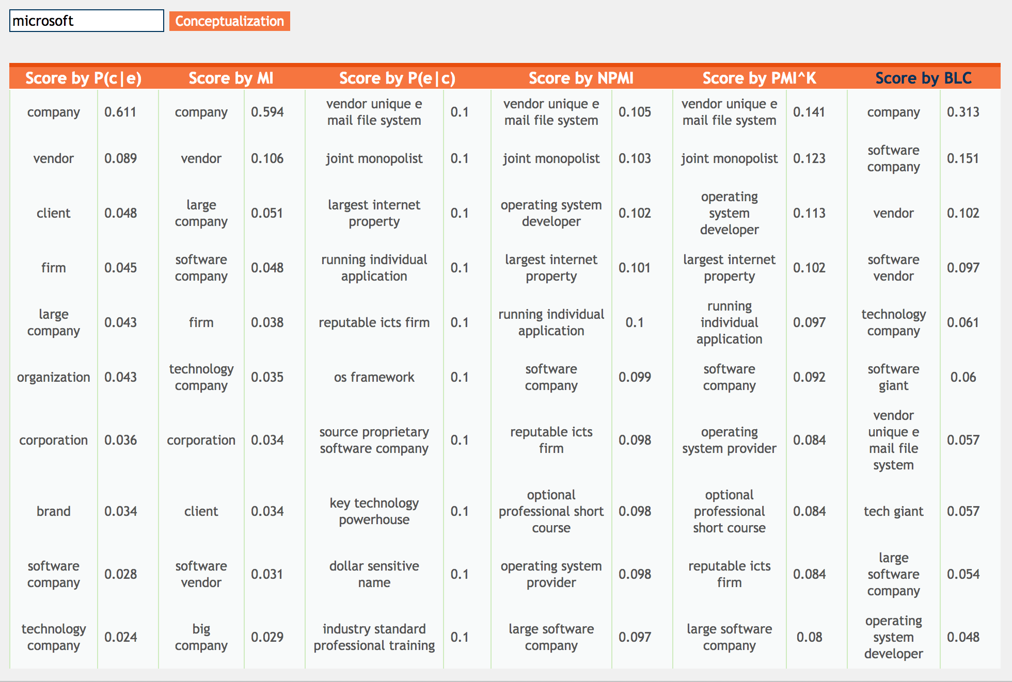
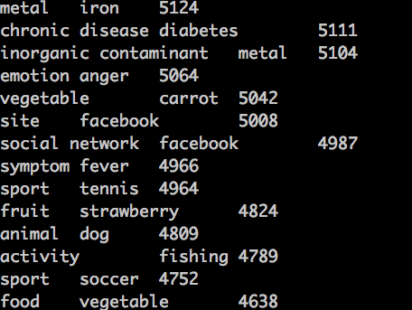
Probase
https://concept.msra.cn/
Notes:
2012 microsoft

Slide 9
Probase
A big graph of concepts
Harnessed from billions of web pages and years' worth of search logs
Released in 2012,
2,653,872 distinct concepts
20,757,545 isA pairs
Currently,
16,937,776 distinct concepts
66,754,640 isA pairs

Slide 10
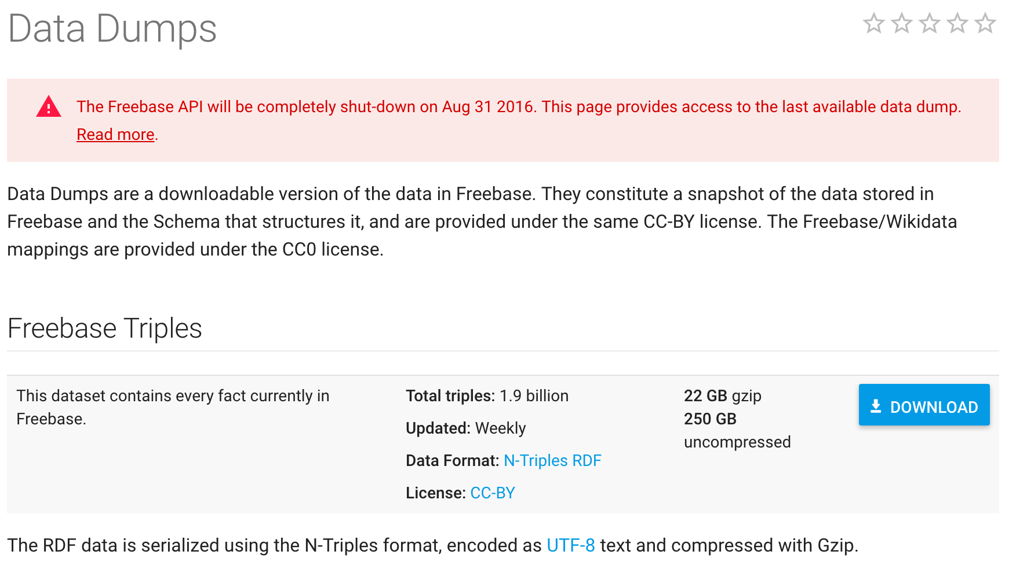
Freebase

Slide 11
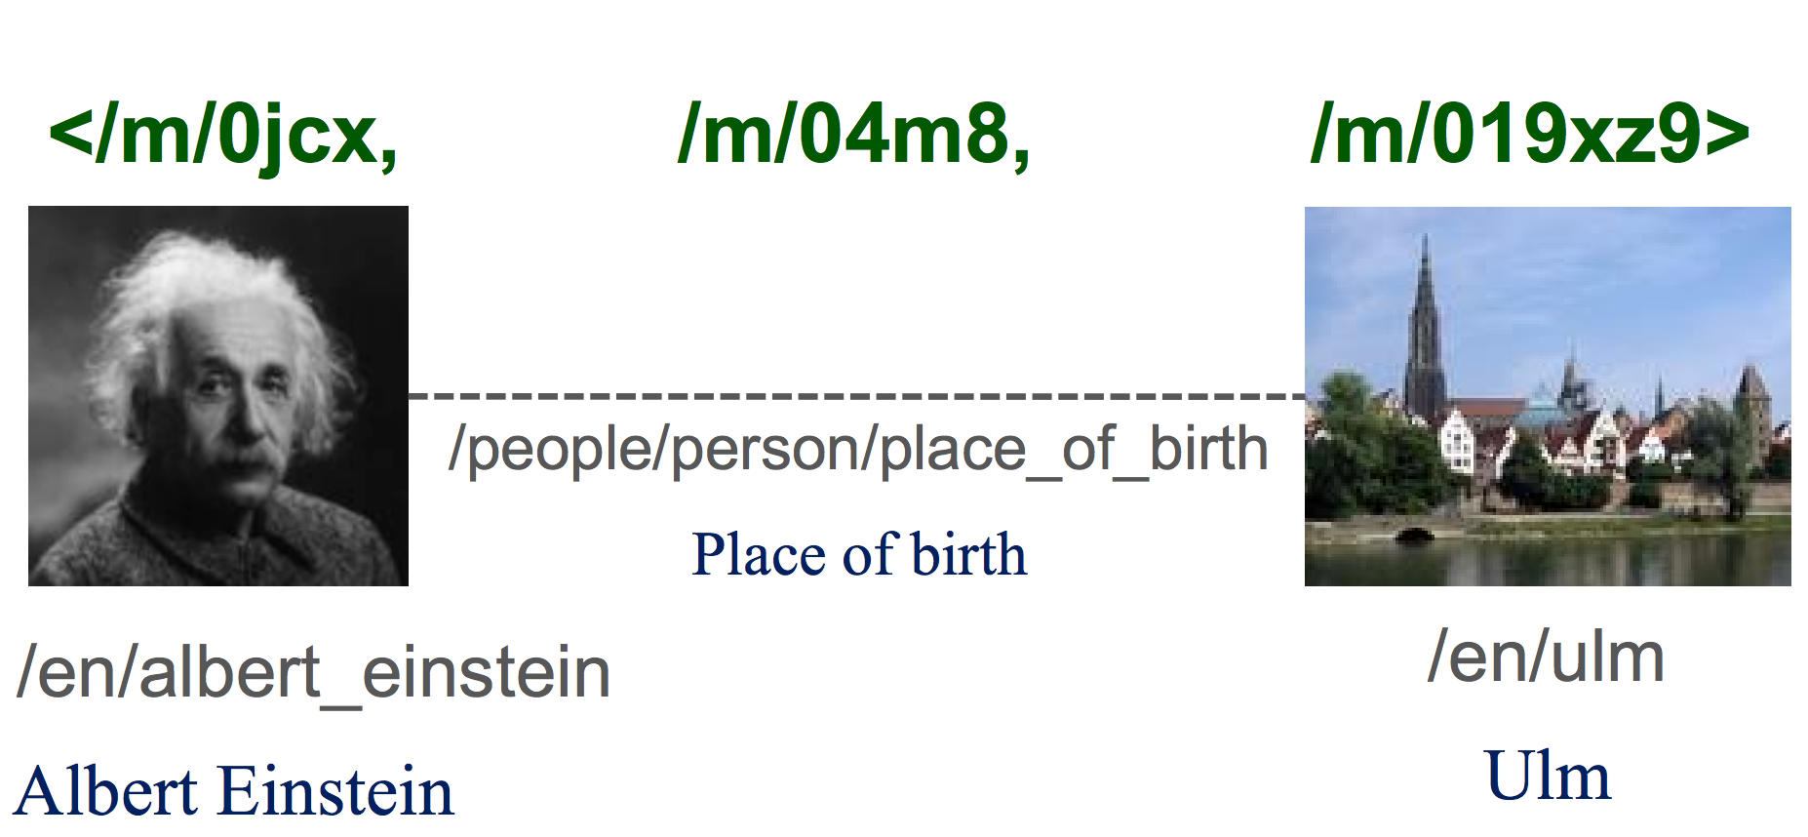
Freebase
Notes:
乌尔姆

Slide 12
Freebase
Freebase was a large collaborative knowledge base consisting of data composed mainly by its community members.
It was an online collection of structured data harvested from many sources, including individual, user-submitted wiki contributions.
47.5M entities
2.9G facts
Notes:
Besides user-contributed data, Freebase integrated data from Wikipedia, NNDB,22 FMD,23 and Mu- sicBrainz.24

Slide 13
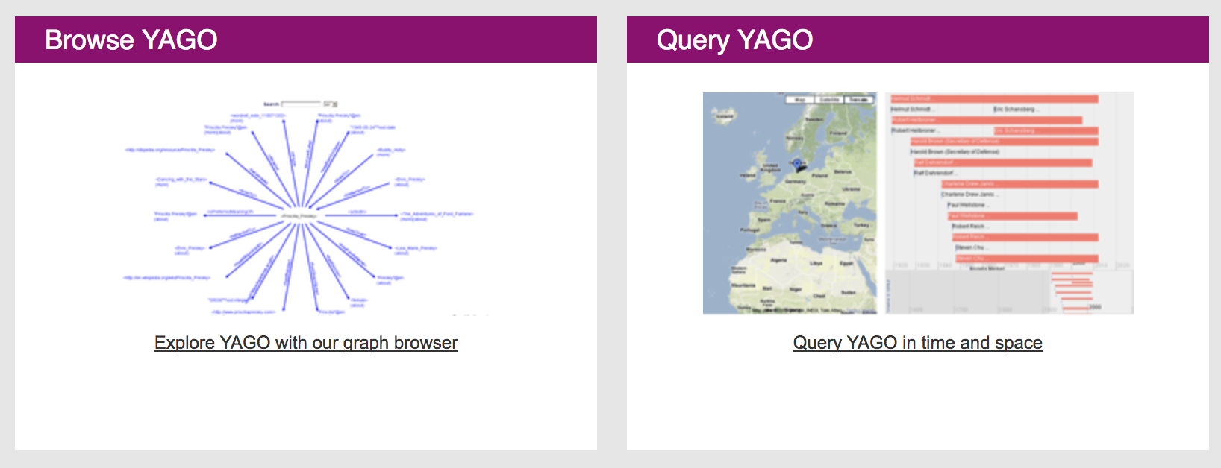
YAGO
http://www.mpi-inf.mpg.de/departments/databases-and-information-systems/research/yago-naga/yago/

Slide 14
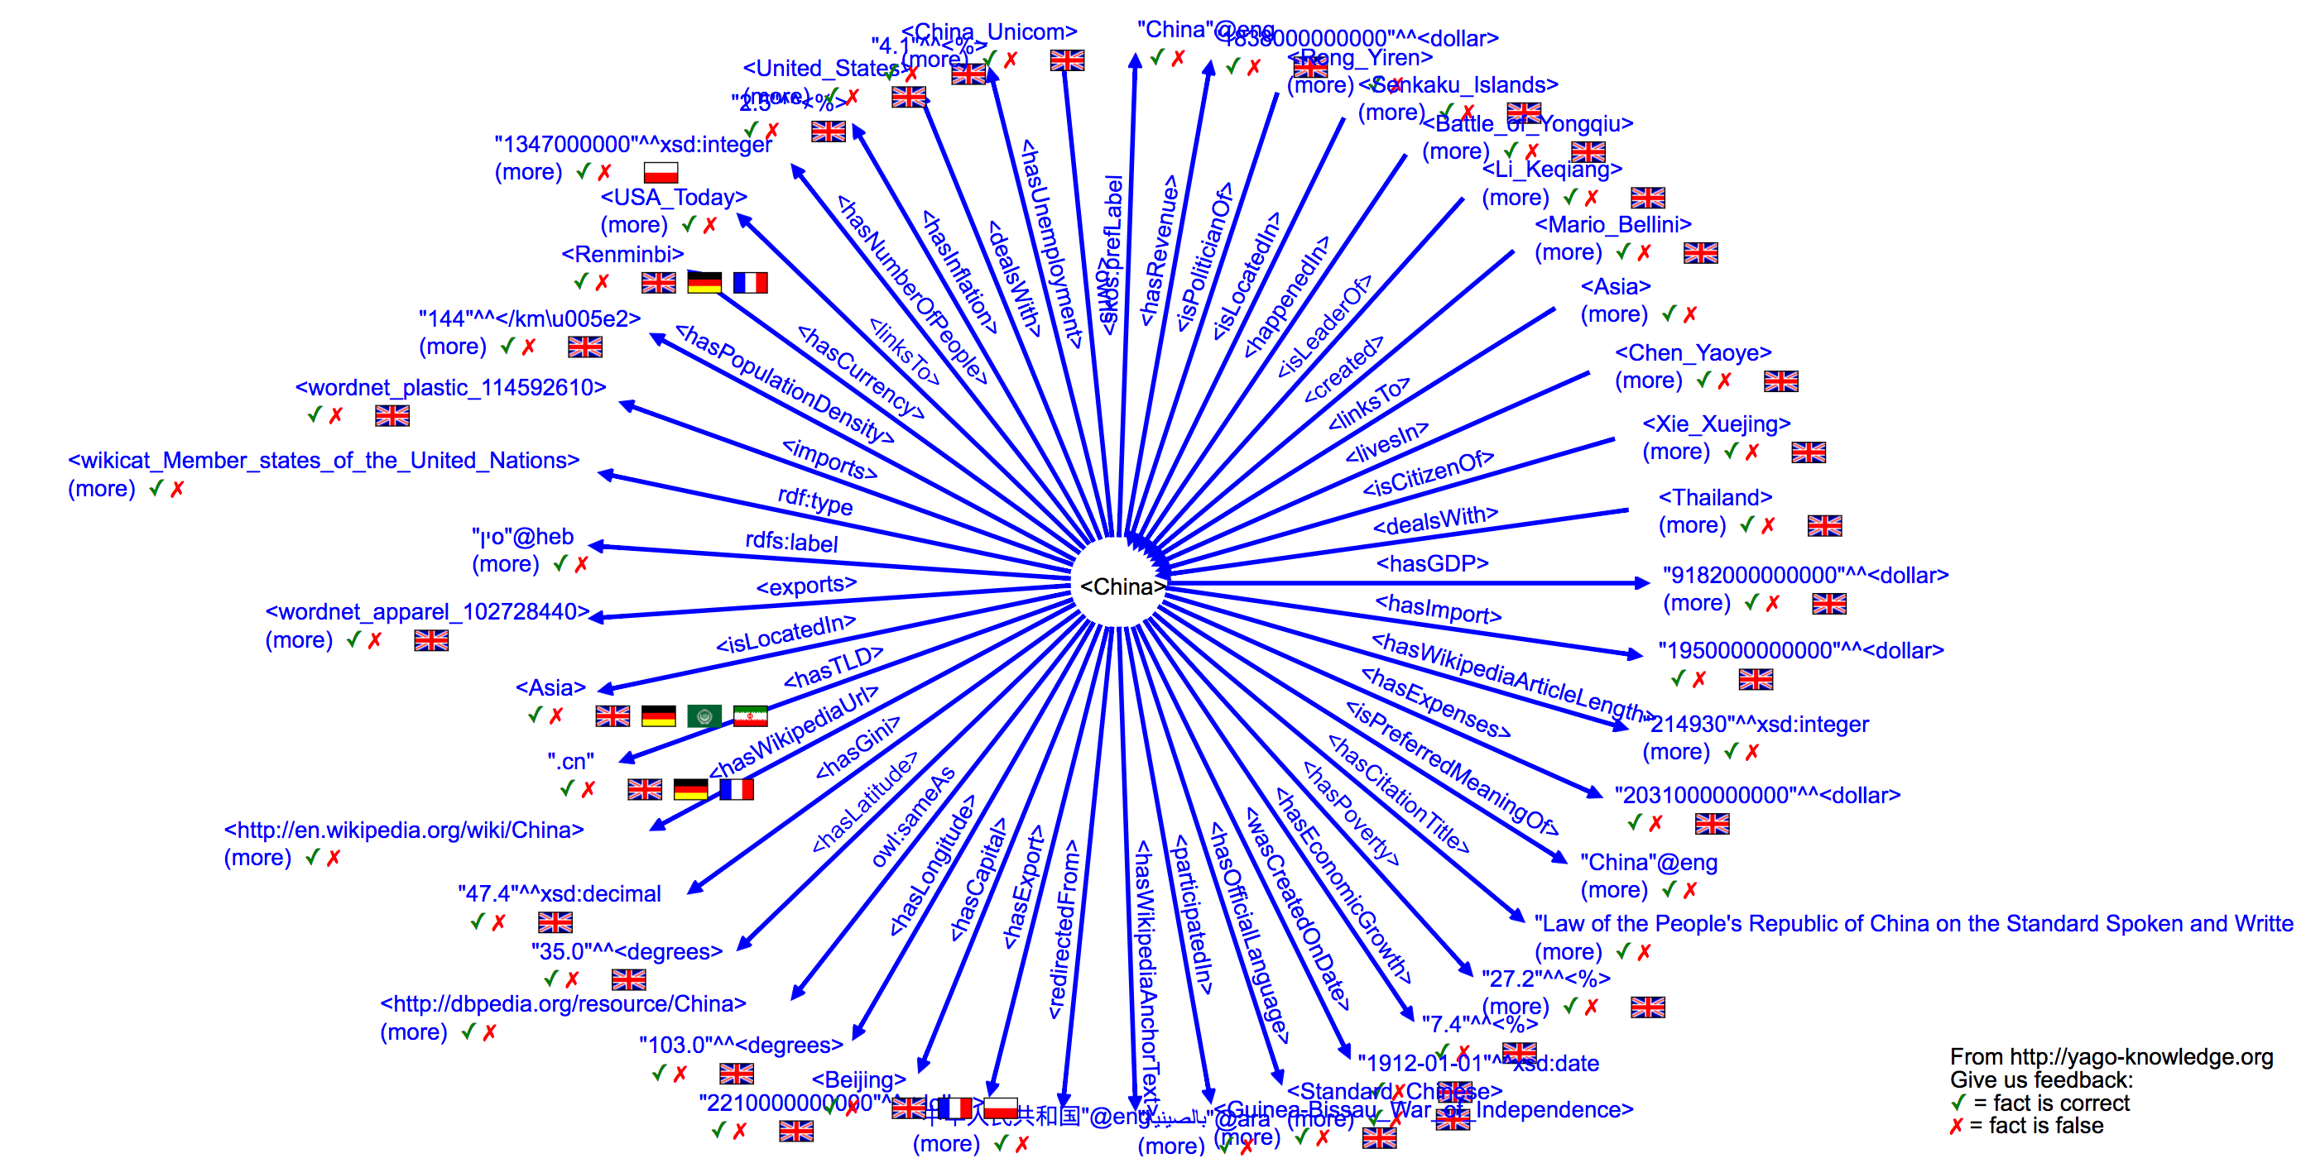

Slide 15
YAGO
YAGO is a huge semantic knowledge base, derived from Wikipedia, WordNet and GeoNames.
Currently, YAGO has knowledge of more than 10 million entities (like persons, organizations, cities, etc.) and contains more than 120 million facts about these entities.
Notes:
YAGO comprises information ex- tracted from the Wikipedia (e.g., categories, redi- rects, infoboxes), WordNet[23] (e.g., synsets, hy- ponymy), and GeoNames.

Slide 16
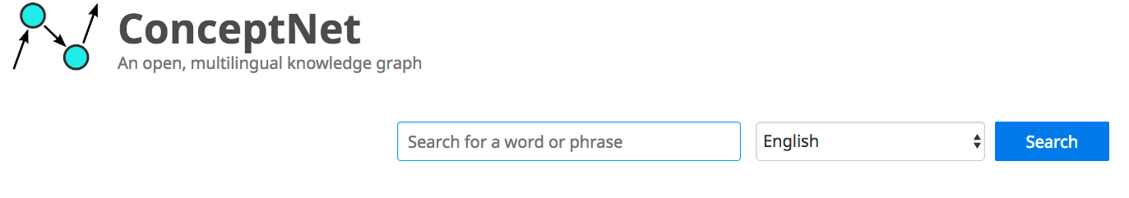
ConceptNet
http://conceptnet.io/
Notes:
ConceptNet expresses concepts, which are words and phrases that can be extracted from natural language text;

Slide 17
ConceptNet
ConceptNet is a multilingual knowledge base, representing words and phrases that people use and the common-sense relationships between them.
The knowledge in ConceptNet is collected from a variety of resources, including crowd-sourced resources, games with a purpose, and expert-created resources.
Notes:
(such as Wiktionary and Open Mind Common Sense)
(such as Verbosity and nadya.jp)
(such as WordNet and JMDict)

Slide 18
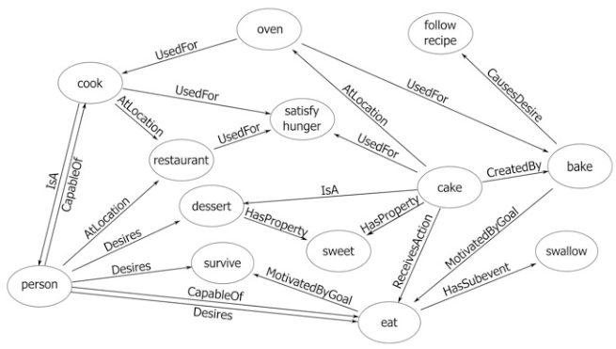

Slide 19
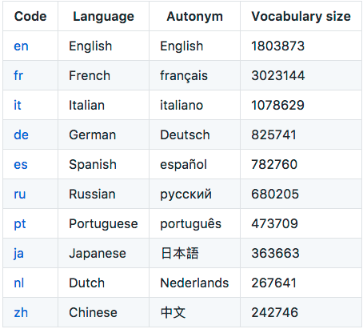
ConceptNet: statistics
Number of statements(edges): approximately 28 million
Number of languages used: 10 core languages and 304 languages are supported in total.
The resulting graph has 9,611,524 distinct edges among 3,930,196 nodes.

Slide 20
Summarization
WordNet
Synset as Node, mainly hypernym/hyponym relation
Probase
Concept as Node, isA relation
Freebase
Entity as Node, mainly real word relation
YAGO
（Entity/Type, predicate, Entity/Type）
ConceptNet
Concept as Node, mainly common sense

Slide 21
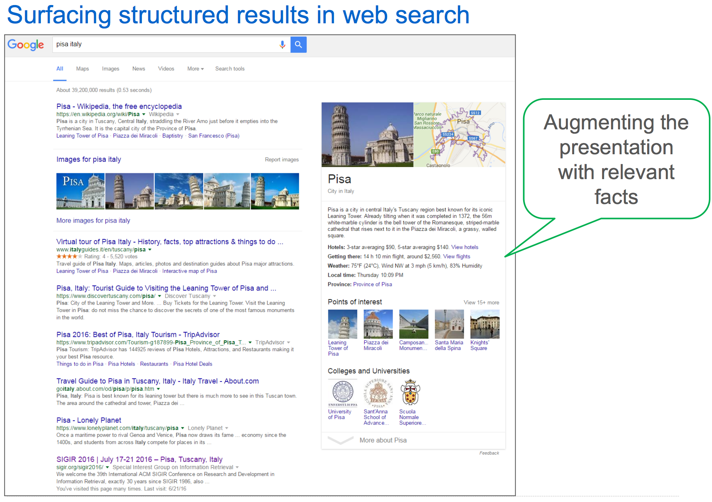
Application

Slide 22
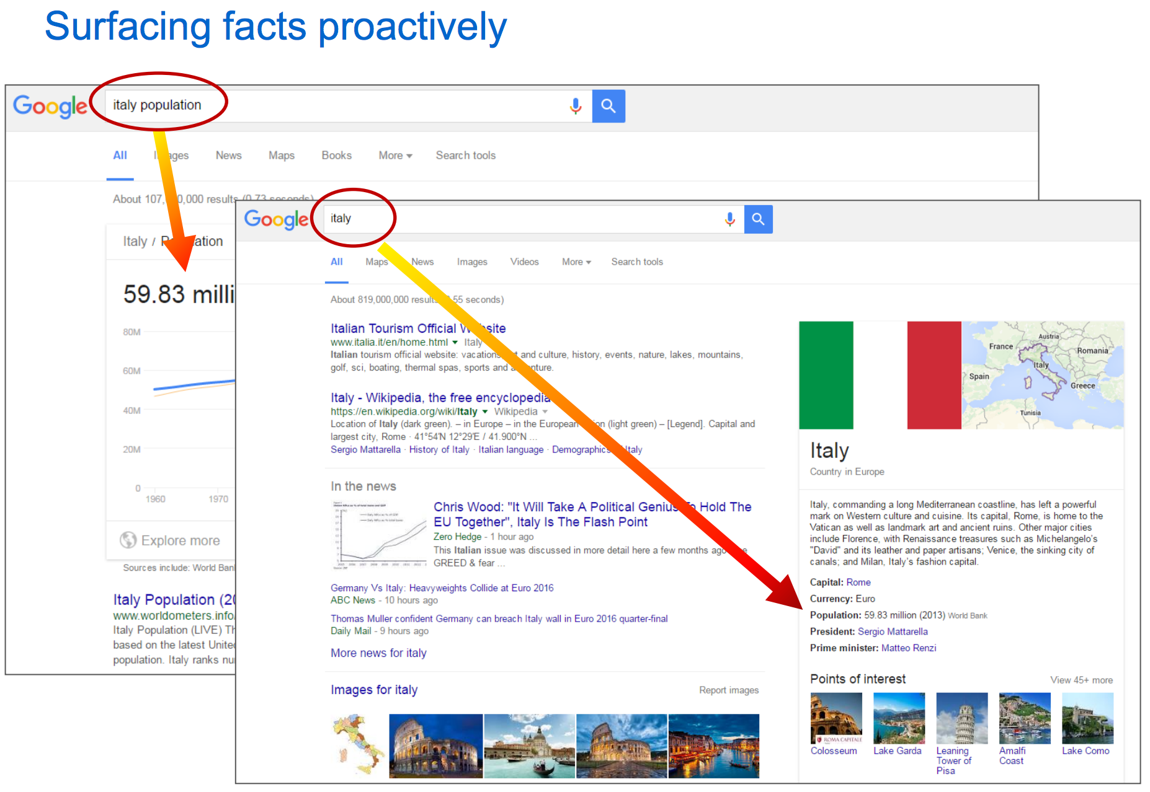

Slide 23
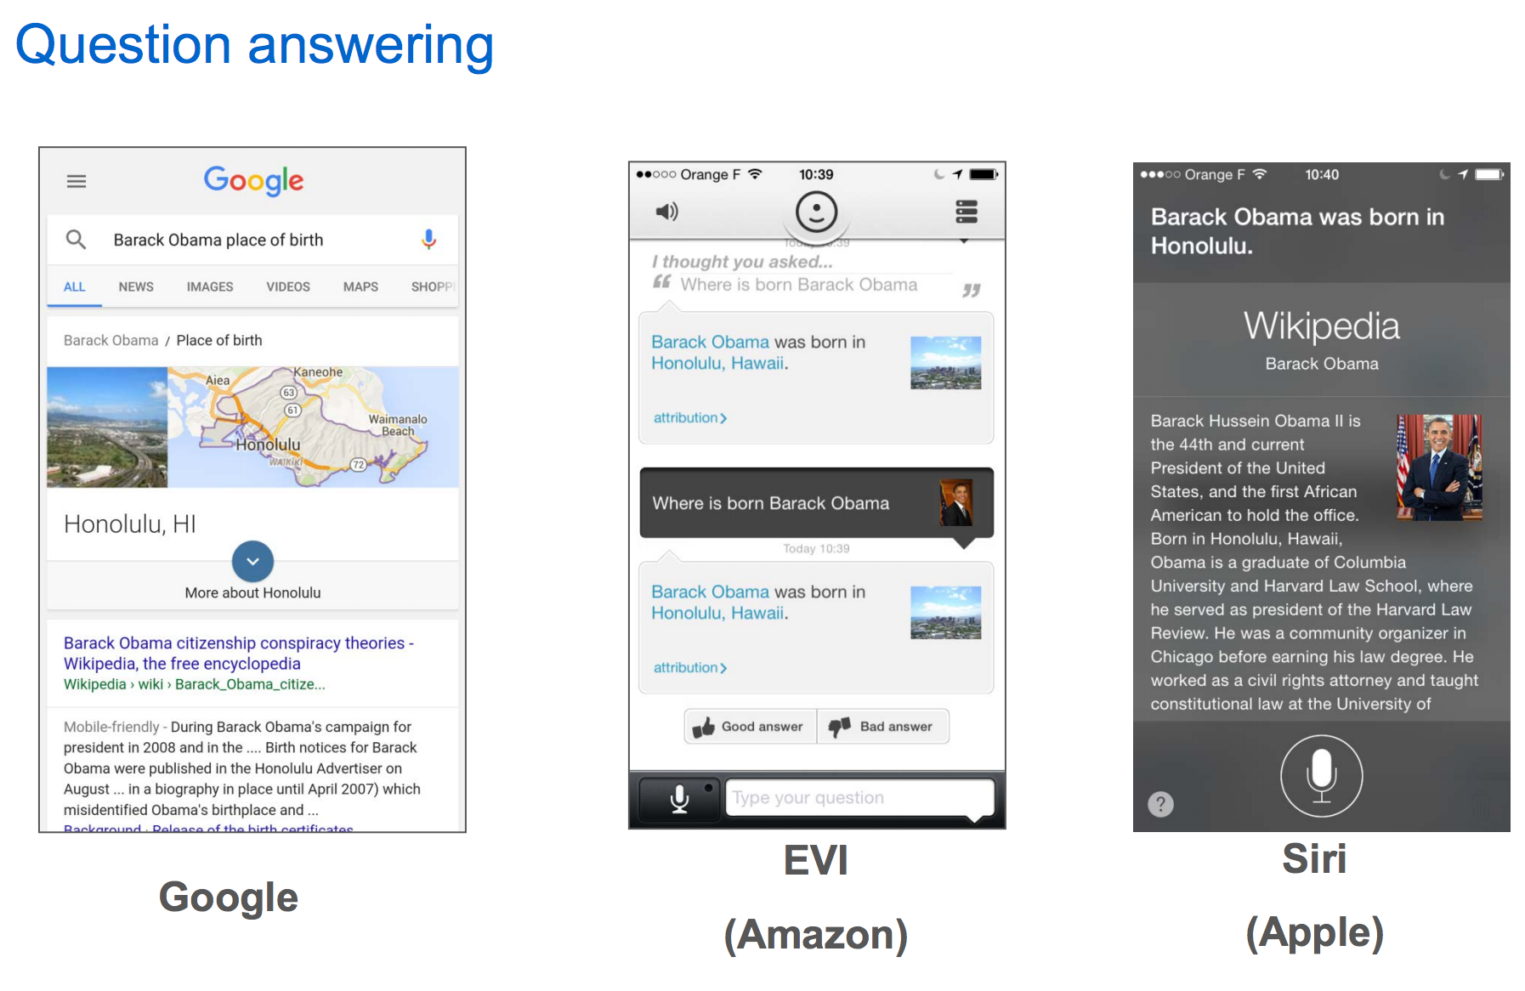

Slide 24
Thank you!

